Slide 1
Assessment of disability inclusion in local governance 2023
1

Slide 2
INTRODUCTION
2
1
4
Introduction
Disability inclusion in public services delivery
2
5
Overall characteristics of survey sample
Disability inclusion in natural disaster risk response
3
Disability inclusion in public administrative procedures
6
Conclusion and recommendations

Slide 3
INTRODUCTION
3
Creates opportunities for people with disabilities (PWD) to share their opinions
Results from 2022 Pilot Assessment
Assessment of disability inclusion in local governance 2023
Complements annual PAPI
Selected PAPI indicators
Gives recommendations on disability-inclusive policies

Slide 4
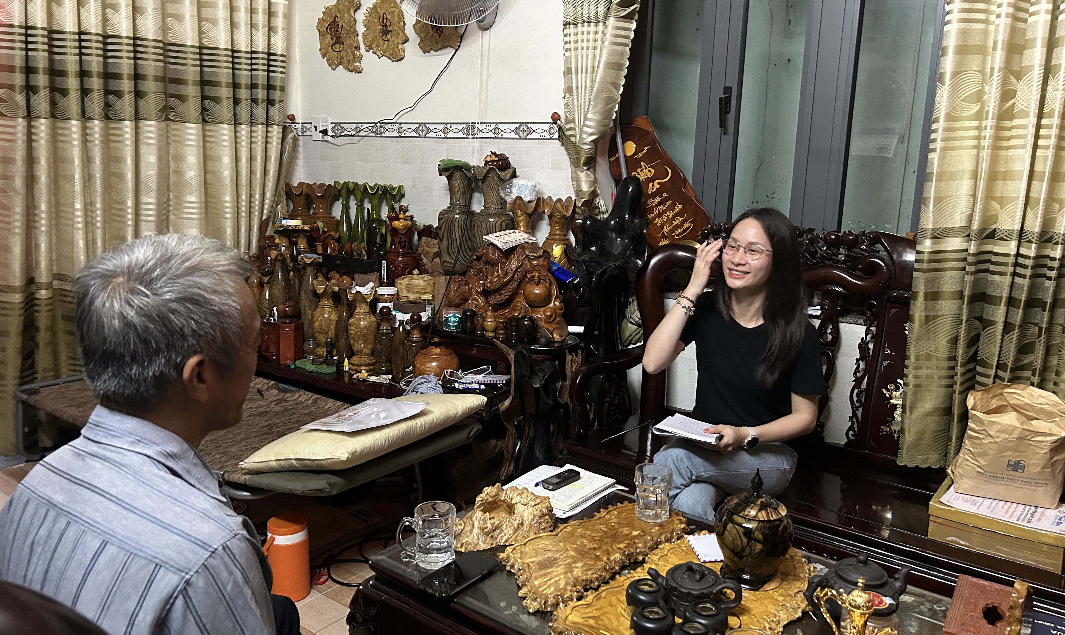
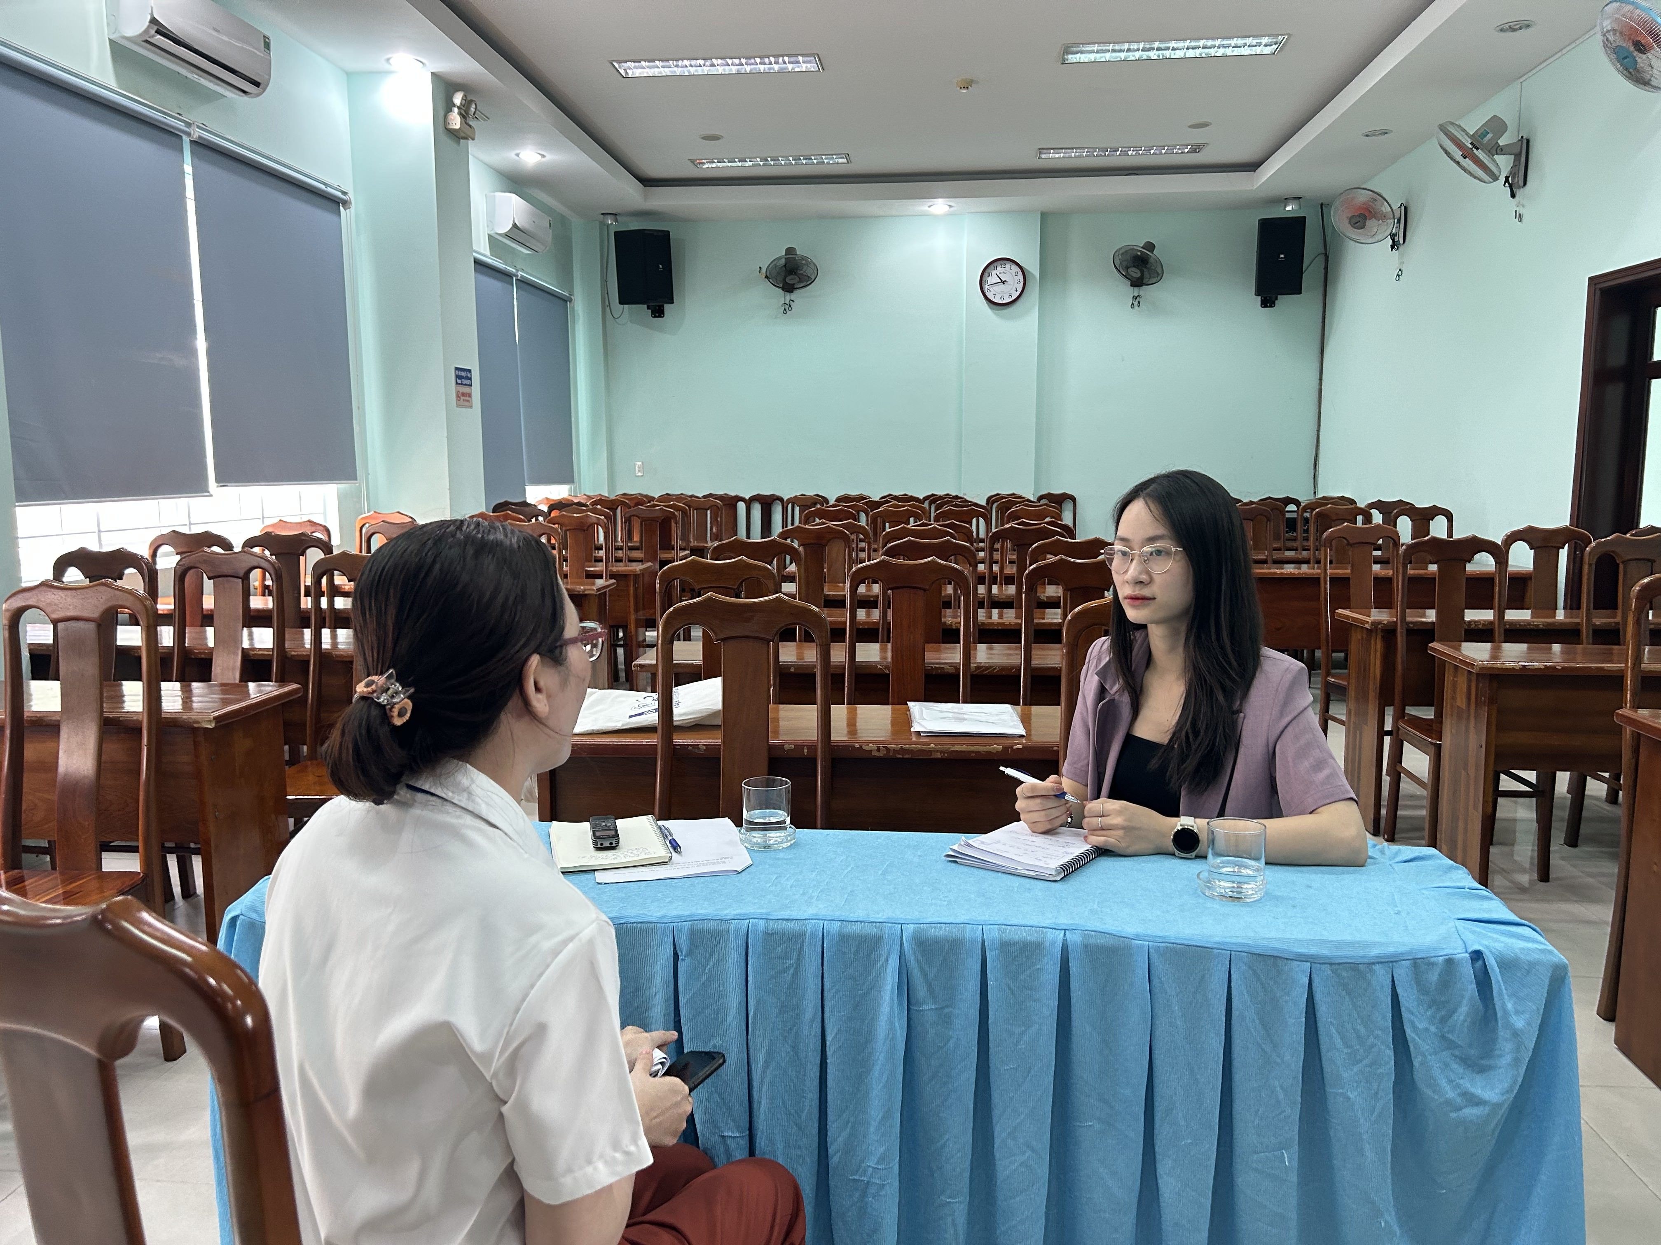
RESEARCH DESIGN
4
INTRODUCTION
QUANTITATIVE SURVEY
ANALYZE DATA
REPORT KEY THEMES/ISSUES
Select story-telling cases for key themes/issues from the quantitative data
QUALITATIVE
INTERVIEWS
Representative cases for key themes/issues

Slide 5
QUANTITATIVE SAMPLING METHOD
5
INTRODUCTION
Sample list
Original sample list includes 33,889 PWDs Compiled by UNDP from local sources and the 2022 pilot assessment
Province selection
Select 6 regions Select 3 provinces from each region Method: probability proportional to size Data: 2019 Population and Housing Census Total sample size: 6,975
Sampling
Select 350 official samples for each region 58 for each disability type) Multi-disability: select 1 representative disability type
Survey sample size
Goal: 2,100; actual sample size: 2,114 Response rate: 40.6% Refusal rate: 7.5%

Slide 6
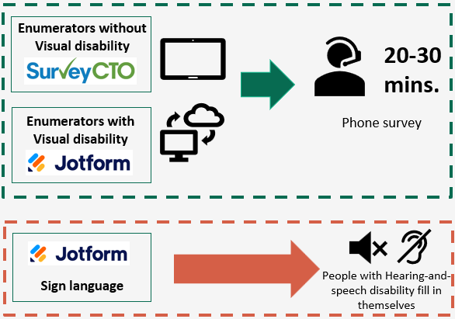
SURVEY TOOLS AND METHODS
6
INTRODUCTION
Enumerators include both those with and without disabilities
Questionnaire topics:
General information about PWD
Accessibility of local public administrative procedures
Accessibility of local public service delivery
PWD’ participation in local response to disaster risks
53.1% PWD answer the phone themselves
40.1% Guardians respond in place of PWD
6.8%
PWD fill in Jotform themselves

Slide 7
KEY FINDINGS
7

Slide 8
OVERALL CHARACTERISTICS OF SURVEY SAMPLE
8
EDUCATION, EMPLOYMENT, AND INCOME
ACCESSIBLE INFORMATION FORMATS

Slide 9
OVERALL CHARACTERISTICS OF SURVEY SAMPLE
9
EDUCATION, EMPLOYMENT, AND INCOME
48.4% | Did not attend school or did not finish primary school. | 29.3% | Currently employed. | 39.6% | Have a monthly income under 4 million VND.
58.4% | Ethnic minority individuals did not attend school or did not finish primary school. | 22.6% 20.8% | Self-employed (non-agriculture). Self-employed (agriculture). | 16.3% | Do not have personal income.
10.3% | More women did not attend school or did not finish primary school than men. | 8.9% | Fewer women are currently employed than men. | 10.2% | More women have a monthly income under 4 million VND than men.
Social insurance: 13.5%

Slide 10
ACCESSIBLE INFORMATION FORMATS
10
OVERALL CHARACTERISTICS OF SURVEY SAMPLE
Audio is the most popular information format.
Texts on computers/phones/technological devices and audio are reported to be Adequate/Perfectly adequate by most.
Braille is reported to be Very scarce/Lacking by most.

Slide 11
DISABILITY INCLUSION IN PUBLIC ADMINISTRATIVE PROCEDURES
11
EXPERIENCING PUBLIC ADMINISTRATIVE PROCEDURES
DISABILITY CERTIFICATION

Slide 12
DISABILITY INCLUSION IN PUBLIC ADMINISTRATIVE PROCEDURES
12
EXPERIENCING PUBLIC ADMINISTRATIVE PROCEDURES
Human factor – The role of local officials:
Local officials’ knowledge and awareness about PWDs => attitude towards and level of support for PWDs
Satisfied: “very enthusiastic”, “fast-responding”, “prioritized”, “work from their hearts”
Dissatisfied: “wouldn’t believe [I am a PWD]”, “dour and indifferent”, “didn’t serve [PWD] even when there was no one”
Barriers in accessing information technology infrastructure:
Most PWDs cannot carry out admin procedures on digital environments via digital information platforms due to accessibility issues (e.g., lacking skills or equipment, …)
Infrastructure systems are not yet consistent and not yet convenient for PWDs.
PAPI 2022
4.2/5
Satisfaction level

Slide 13
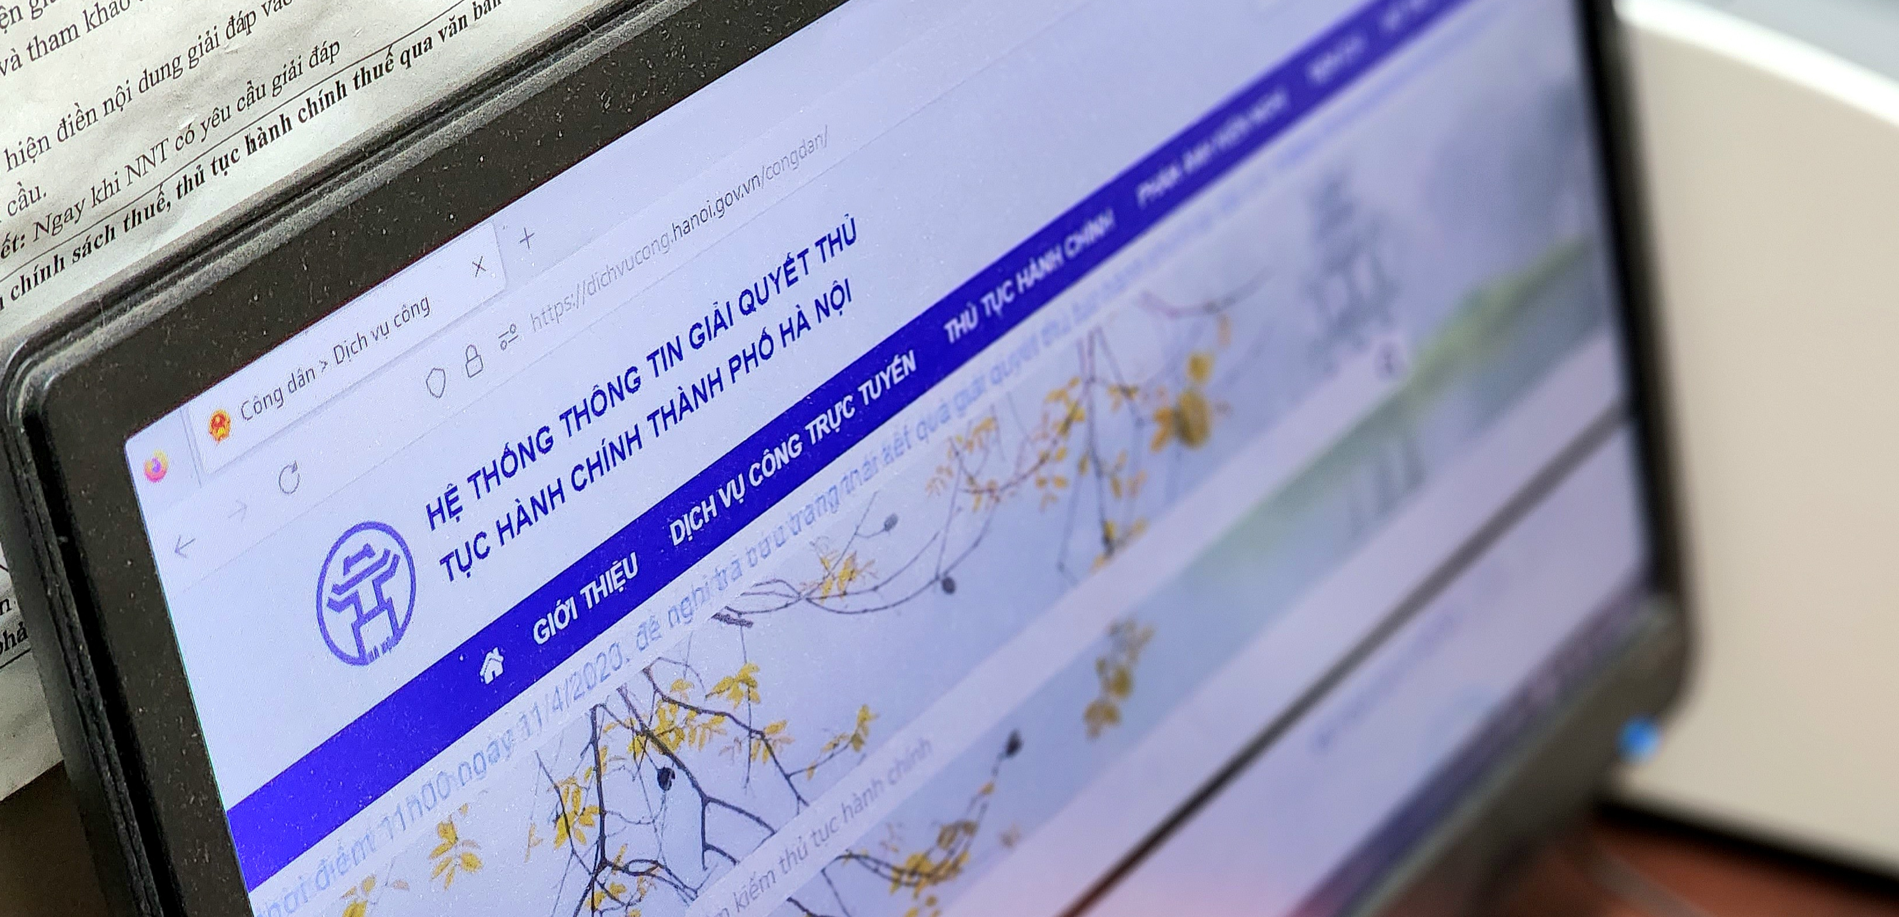
INFORMATION CHANNELS FOR ADMINISTRATIVE PROCEDURES
13
DISABILITY INCLUSION IN PUBLIC ADMINISTRATIVE PROCEDURES
Popular information channels for PWDs:
Local PWD associations
Zalo groups (of residential groups, …), social media, Google
Commune-level People’s Committees (mostly connected through Zalo groups for heads of residential groups)
Only 37.8% of the PWDs used the Internet, and mainly through smartphones.
Accessibility levels of mass media channels on TV are not sufficiently high for PWDs.
“I “saw” on the TV […] there seemed to be legal support services for the vulnerable […] but I didn’t know the phone number written on the screen, they said so.”
IDI female with Extremely severe Visual disability, U60
PAPI 71%
2022 has Internet at home

Slide 14
DISABILITY INCLUSION IN PUBLIC ADMINISTRATIVE PROCEDURES
14
DISABILITY CERTIFICATION (DC) PROCEDURES AND ASSOCIATED BARRIERS
Connection between local authorities and PWDs
Mostly reliant on social affairs organizations and residential groups, especially PWD Associations.
Barriers in DC procedures
Existing procedural complexity.
Lack of specific instructional regulations, especially for ‘Others’ type.
Limited local personnel:
Only 1 LISA official at the commune/ward level.
Some communes/wards do not have OPDs at the commune/ward level or their representative in local DC committee.
Members of DC committees have limited knowledge and skills.

Slide 15
DISABILITY INCLUSION IN PUBLIC ADMINISTRATIVE PROCEDURES
15
SOCIAL SUPPORT FOR INDIVIDUALS WITH DCs
Existing inadequacies in perception of
the importance of DC
Especially for mild PWDs, e.g.:
Mild PWDs do not have free health insurance or disability allowance, so do not need to obtain DCs.
Concern of social stigma against PWDs:
DC ownership affects prospects of post-secondary education and of employment.
Some are worried about being “out” as PWD.
However, ownership of DC, regardless of severity, will support PWD more meaningfully in their lives.
“not being isolated in society. […] wherever he goes he has the DC.”
IDI mother of a U50 man with intellectual disability
“A: with a DC, when a PWD goes outside […] to some places, he may have 50% discount or free of charge. […]
Q: So it means that he will have other social benefits rather than just the allowance?
A: Yes, that’s right.”
IDI woman with Physical disability, U50
75.4% rated health insurance helpful to very helpful.
Health insurance covers 100% cost of the 19-day hospitalization :
“(Health insurance covers) 100%, so it was not a big deal. Before, […] when I was not covered 100%, I had to pay both for the lodging and food, up to 1.7 million VND, [...] now I only have to pay for food.“
IDI female with Severe disability, U70
PAPI
2022
3.6/4

Slide 16
DISABILITY ALLOWANCE
16
DISABILITY INCLUSION IN PUBLIC ADMINISTRATIVE PROCEDURES
> 90% of People with Severe or Extremely severe Disabilities have received disability allowance or other social support.
Besides disability allowance, PWD with work capacity wish to participate in the labour market to feel independent and included in their communities.
Barriers in employment of PWD:
Vocational training: high costs, lack of diverse programs that are suitable for various disability types
Recruitment: disconnect between job placement and actual recruitment
“I’m satisfied with however much (allowance) the State can support. […] I want to work, earning 3 million dongs per month to support my mum.”
IDI male with Severe Multi-disabilities, 42 years old
“In case I want to use something, in case I want to buy something, I don’t have to rely on someone else.”
IDI male PWD who earns 4 million VND a month
“The ultimate desire of PWD is to be included in their communities in all aspects: economic, environmental, social, etc”
IDI local Labor, Invalids & Social Affairs (LISA) official
Average minimum expense need:
1,500,000 VND.

Slide 17
RECAPS AND RECOMMENDATIONS
17
ACCESSIBILITY OF PUBLIC ADMINISTRATIVE PROCEDURES
DC procedures are still complicated and unclear – Updated guidelines and procedures are necessary to:
Disability allowance and other social support do not yet meet accessibility needs of PWD
Regulations on admin procedures for PWD in digital transformation are not yet flexible
Consider challenges for PWD in accessing IT, and have suitable procedural mechanisms for them.
Reduce DC processing time.
The average minimum demands for living expenses of PWD are higher than the current amount of disability allowance.
Certification of types and severity of disability should be more understandable and reasonable for DC committee members without healthcare expertise.
Local officials need more capacity-building on knowledge and skills to communicate with PWD to support them more dedicatedly and effectively.
PWD also wish to participate in the economy to generate their own income.
Raise awareness of both officials and PWD of the importance of the DC process and DC ownership.
Better emphasize the roles of local OPDs in helping PWD access information and implement PWD-related policies.

Slide 18
DISABILITY INCLUSION IN PUBLIC SERVICES DELIVERY
18
LOCAL PUBLIC HOSPITAL SERVICES
LOCAL PUBLIC REHABILITATION SERVICES

Slide 19
DISABILITY INCLUSION IN PUBLIC SERVICES DELIVERY
19
QUALITY OF LOCAL PUBLIC HOSPITAL SERVICES
PWD’s rating of local public hospitals’ quality
Infrastructure criteria are rated lower than criteria on staff members’ attitude, waiting period, and expenses.

Slide 20
DISABILITY INCLUSION IN PUBLIC SERVICES DELIVERY
20
ATTITUDE OF MEDICAL STAFF
Proportion of PWD agreeing with the statement “Treated with respect”
Overall, most PWD (89.1%) highly appreciate medical staff’s attitude.
Words used to describe medical staff’s attitude include “polite”, “respectful”, “cheerful”, “kind”, “non-discriminatory”…
However, there are 7.9% of PWDs that have had bad experience regarding the attitude of medical staff.
Words used to describe medical staff in these cases include disdainful, conceited, arrogant, offensive…
"...For staff at lower levels, their attitude tends to be even more arrogant... I am very satisfied with the doctors, but for the other staff, to be honest, I find them offensive.“
IDI with a person with Physical disability

Slide 21
DISABILITY INCLUSION IN PUBLIC SERVICES DELIVERY
21
ATTITUDE OF MEDICAL STAFF
Doctors (per 10,000 population) (source: GSO)
The rate of PWDs agreeing with the statement 'Treated with respect' is highest in the Northern Midlands and Mountainous region (92.3%); while in the Red River Delta region, this rate is the lowest (86.1%)
=> These are the two regions with the highest and almost lowest doctor-to-population ratio in the country.
Regions | Doctors (per 10,000 population)
Red River Delta | 6.4
Northern Midlands and Mountains | 9.4
North Central Coast | 8.9
Central Highlands | 6.3
Southeast | 8.8
Mekong River Delta | 7.9
Whole country | 8.0

Slide 22
DISABILITY INCLUSION IN PUBLIC SERVICES DELIVERY
22
WAITING PERIOD
Proportion of PWDs agreeing with the statement “Reasonable waiting period”
Most PWDs (77.4%) do not have to wait too long for medical examinations. Additionally, some hospitals consistently prioritize PWDs (Article 3, 2023 Law on Medical Examination and Treatment)
“Firstly I am prioritized (without having to wait) […] They (doctors, nurses and medical staff) will see me when I walk in (they will prioritize me, no need to ask)”
IDI with a person with
Physical disability, U40

Slide 23
DISABILITY INCLUSION IN PUBLIC SERVICES DELIVERY
23
WAITING PERIOD
However, 17.9% of respondents still have to wait for a long period of time. Some PWD feel “ignored” due to no available seat, forcing them to stand during the waiting period, with no particular support provided by hospital staff.
“To be honest, it's really disheartening. I mean, I have a disability, but when I go for a checkup, I receive no additional support [...] It's the same story in almost every hospital; there's no support for PWD, almost none [...] Me, a PWD just standing there without a seat, I just feel ignored. The hospital staff is all around, but they just ignore me. There seems to be no extra consideration for PWD, even though I am a PWD.
You know, I noticed a big difference last year when I went to the airport. They actually cared, cared for PWD [...] they had wheelchairs and helped me get around. Even getting on the bus to the plane, they prioritized me, made sure I had a seat. Even the other passengers on the same flight were willing to stand up and give their seats to me.
It just makes me wonder, we're all humans, right? So why don't the hospital staff treat people like me with the same respect as everyone else does?“
IDI with a person with Physical disability, U60

Slide 24
DISABILITY INCLUSION IN PUBLIC SERVICES DELIVERY
24
EXTRA COST FOR BETTER TREATMENT
About 7% PWD interviewed claimed that extra cost (bribery) is necessary for better treatment.
Proportion of PWD having to pay bribery for better treatment, disaggregated by economic regions
“Because this (bribery) is necessary for me to be properly attended by doctors [...] Like when I got a surgery, when it was done, I was unconscious, but my family didn’t know that they had to give them money, only after seeing my eyes rolling back (indicating my situation is getting worse) did my family give them money. Only after that did the doctors give me an injection, and I woke up after receiving the injection…”
IDI with a person with Physical disability, U40
The proportion of PWD having to pay bribes for better treatment in the Red River Delta region is the highest (13.9%).

Slide 25
DISABILITY INCLUSION IN PUBLIC SERVICES DELIVERY
25
LOCAL PUBLIC REHABILITATION SERVICES
Proportion of PWD who use local rehabilitation services
Very few PWD (3.3%) have used local rehabilitation services in the past year due to the following reasons:
Currently, rehabilitation services at the district level are limited, and not every locality provides these services.
The cost of rehabilitation services is relatively high, “up to 10 million VND per month without health insurance”.
There is a lack of consensus on the health insurance coverage list for rehabilitation services between treatment parties and coverage provision parties.

Slide 26
DISABILITY INCLUSION IN PUBLIC SERVICES DELIVERY
26
`
RECAPS AND RECOMMENDATIONS
The district-level healthcare services for PWD are generally highly rated; however, there should be improvement in certain aspects to enhance hospital quality.
Local rehabilitation services are not widely available.
Invest in more disability-inclusive hospital infrastructure (e.g., accessible toilets, wheelchair ramps, etc.).
Further expand the network of rehabilitation facilities at the district level.
Enhance management and supervision of the hospital personnel, including doctors and staff, to reduce instances of briberies and inappropriate conduct.
There should be consensus on the health insurance coverage list for rehabilitation services between treatment parties and coverage provision parties.
Prioritize PWD in medical examination in the hospital policies and practice, e.g., priority appointments, comfortable seating in waiting areas, etc.

Slide 27
DISABILITY INCLUSION IN NATURAL DISASTER RISK RESPONSE
27
IMPACT OF NATURAL DISASTERS
ACCESS TO NATURAL DISASTER WARNINGS
LOCAL SUPPORT
PWD’S PARTICIPATION

Slide 28
IMPACTS OF NATURAL DISASTERS
28
DISABILITY INCLUSION IN NATURAL DISASTER RISK RESPONSE
1. The most affected regions:
- North Central Coast
- Northern Midlands & Mountains
- Central Highlands
2. The most common natural disasters:
- Floods, typhoons /tornadoes
- Droughts
- Hail and lanslide
24.5% of PWD were affected
4. Most of the affected PWD rated the impacts of the disasters as “severe” or “extremely severe”
3. The most affected aspects:
- Agricultural production
- Housing

Slide 29
ACCESS TO NATURAL DISASTER WARNINGS
29
DISABILITY INCLUSION IN NATURAL DISASTER RISK RESPONSE
Channels for warnings
Proportion of PWD receiving
natural disaster warnings
Proportion of PWD not receiving warnings, disaggregated by disability types
The highest rates of "Do not receive information in any format".
The most common channels:
- Television
- Local loudspeakers
Hard to access
People with hearing-and-speech and Visual disabilities also have high rates of not receiving warnings.

Slide 30
LOCAL SUPPORT
30
DISABILITY INCLUSION IN NATURAL DISASTER RISK RESPONSE
PWD’s evaluation of support priority in response to natural disasters:
21.5% of the affected PWD received priority support in local response to natural disasters. Of which:
PWD’s demands of natural disaster response (expressed via recommendations to local authorities)
82.1% were given priority in receiving relief gifts after natural disasters.
Only 4.4% were trained on how to protect themselves and call for support during natural disasters.
The demand to be trained on how to protect themselves and call for support when natural disasters occur was one of the 3 top demands of PWDs, besides demands for basic necessities and facility improvement.

Slide 31
PWD’S PARTICIPATION
31
DISABILITY INCLUSION IN NATURAL DISASTER RISK RESPONSE
Only 5.3% of PWD gave recommendations on responding to natural disasters in the last 5 years.
However, there were some active participants. They not only gave recommendations but also got involved in supporting more vulnerable groups. There were also meaningful recommendations that were implemented afterwards.
“When I worked for the [Fatherland Front], I was reminded very thoughtfully about tasks related to natural disaster prevention and had to pay attention to households that could not [resist storms and floods]. I had also made a list of people who were having difficulties, here there were 3 locations that could be relocated to.”
IDI with a person with Mild Physical disability
There is a considerable difference in the rate of giving recommendations between PWD who participate in local organizations and those who do not.
“And then, they [local officials] also followed my recommendation. According to them, who worked in the provincial government, they thought that this idea was good and could be done.“
IDI with a person with Mild Physical disability

Slide 32
RECAPS AND RECOMMENDATIONS
32
RESPONSE TO NATURAL DISASTER RISKS
Natural disaster warning is found to be not timely and accessible enough for some PWD.
PWD’s engagement in natural disaster response remains limited.
Integrate accessible information dissemination methods for PWD
Promote the PWD’s participation through local organizations, associations, and groups of PWD.
Promote the role as a two-way information channel of township-level governments and local associations in supporting PWDs.
Organize training for PWD in frequently affected areas.

Slide 33
CONCLUSIONS AND RECOMMENDATIONS

Slide 34
CONCLUSIONS AND RECOMMENDATIONS
34
Public administrative procedures
Disability certification procedures remain complicated and ambiguous.
Administrative procedures on digital platforms are generally not accessible enough for most PWD.
Local officials still have limited awareness, communication and support skills when working with PWD.
PWD’s average minimum expense need is higher than the current disability allowance.
Update the disability certification guidelines and procedures.
Consider PWD’s challenges in accessing information technology, and work out accessible administrative procedures for them.
Raise the awareness of both officials and the general public about PWDs.
Do more research and develop appropriate policies to provide sustainable social assistance for PWD and promote the employment of PWD.
PWD wish to participate in the economy to be financially independent

Slide 35
CONCLUSIONS AND RECOMMENDATIONS
35
Public services delivery
Certain aspects of district-level healthcare services need to be improved.
Local rehabilitation services are not yet widely available and affordable at the district level.
Invest in accessible hospital facilities (e.g. accessible toilets, wheelchair ramps…).
Increase the number of rehabilitation facilities at the district level.
Suggested research topics:
- Role of OPDs
- Discrimination
- …
Response to natural disaster risks
Accessing natural disaster warnings remains challenging for many PWD.
PWD are not fully engaged in natural disaster risks response.
Early warnings for natural disasters should be accessible.
Enhance PWD’s autonomy and proactiveness in disaster risk response through training.

Slide 36
THANK YOU!

